Slide 1
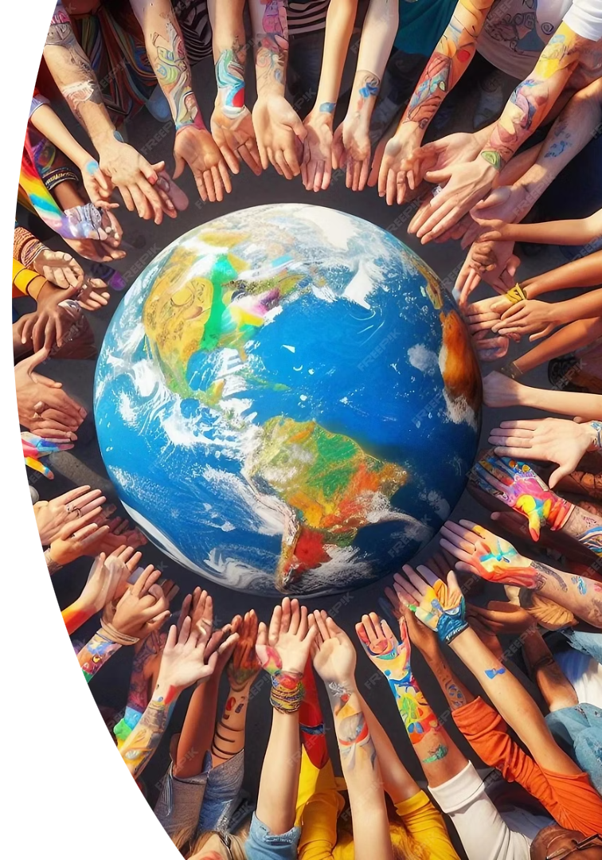

Introducing the Urantiathons: A Global Virtual Gathering
Unite with a global community through connections and collaboration worldwide.
by Juan Jaramillo, Conference Committee Chair

Slide 2
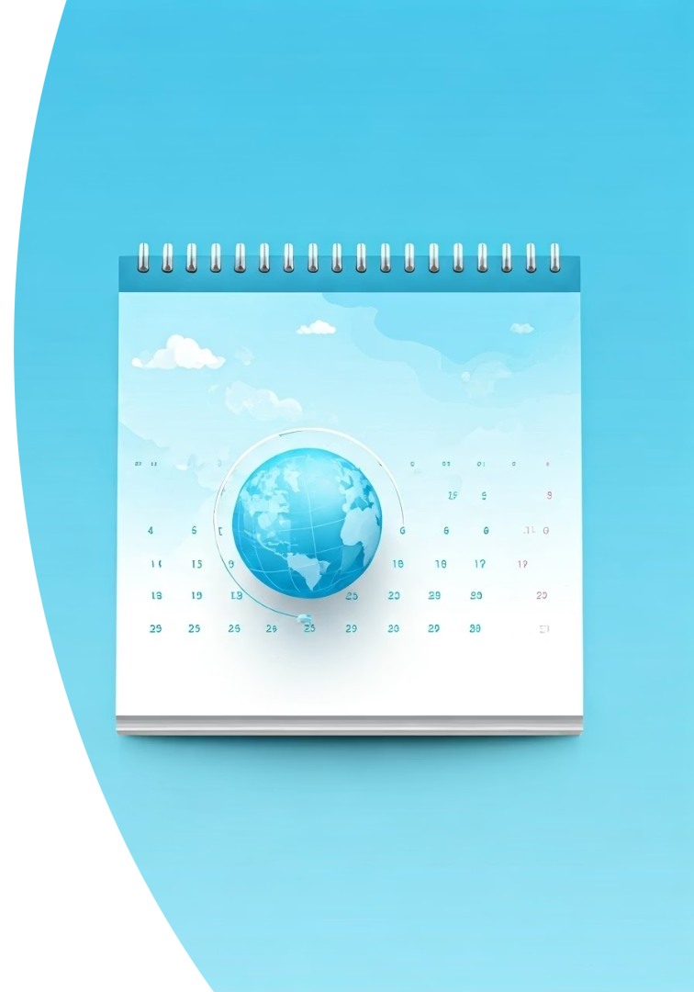
What is the Urantiathon?
Duration
Programming
1-2 days with flexible scheduling
8-24 hours of engaging content daily
Purpose
Connects global readership
Showcases regional activities

Slide 3
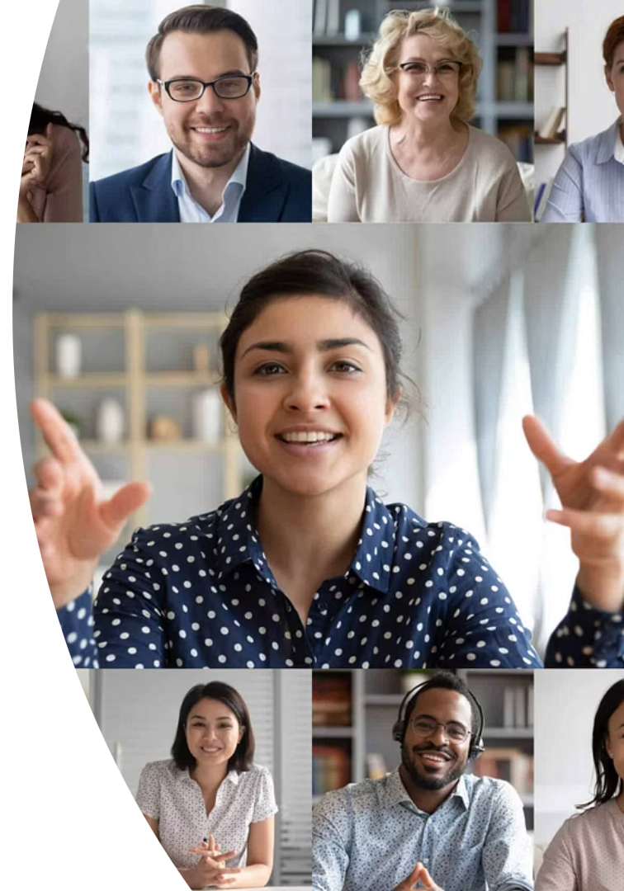



Core Structure: Featured Presentations
Expert Keynotes
Presentations from knowledgeable leaders
Varied Topics
Spirituality, culture, global perspectives
Diverse Insights
Fresh ideas and meaningful dialogue

Slide 4
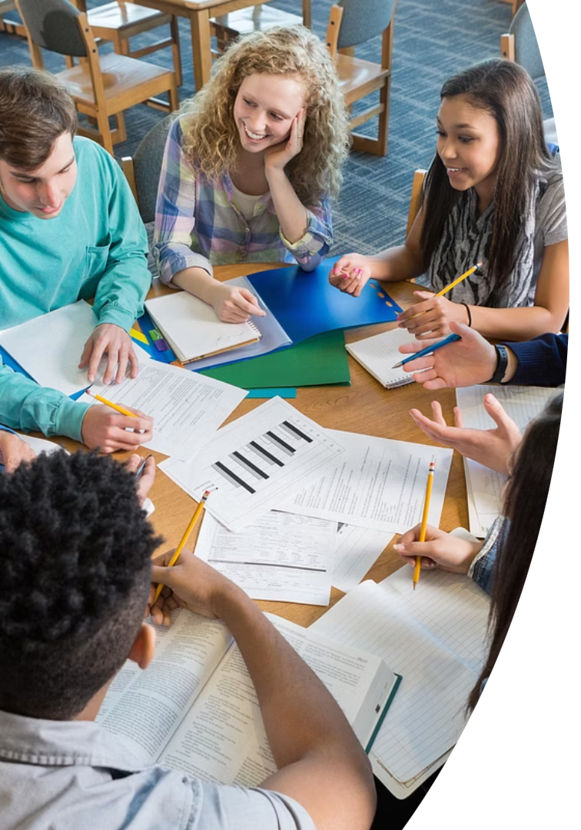



Interactive Workshops: Deep Dive Sessions
Private Workshops
Exclusive sessions with personalized engagement
Multilingual
Several languages for global reach
Cultural Exchange
Regional activities and collaborative learning

Slide 5



The Global Audience: A Diverse Community
Worldwide Connections
Bringing readers together across continents
Multiple Languages
Support for diverse linguistic backgrounds
Global Reach
Celebrates international movement growth

Slide 6
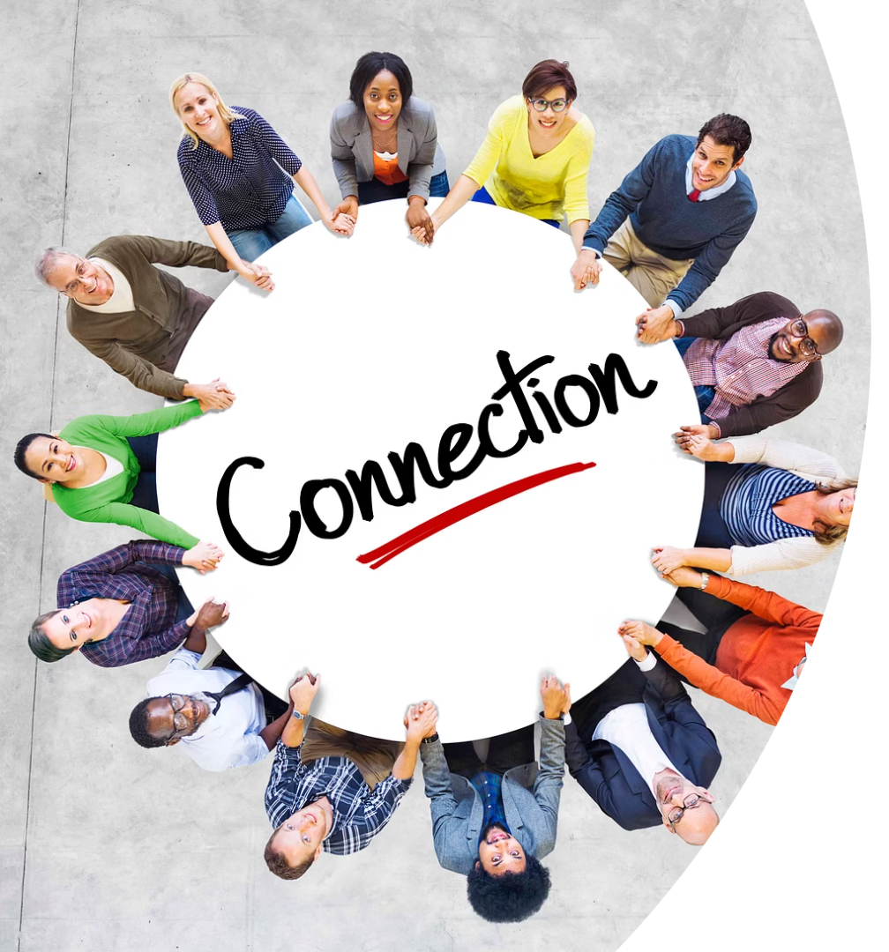
Regional Activities: Showcasing Local Efforts
Successful Initiatives
Highlighting impactful community projects
Best Practices
Sharing valuable lessons to inspire others
Innovation
Encouraging collaboration across regions

Slide 7






Association's Support: Guidance and Framework
Quality Assurance
Ensuring engaging global conferences
Guideline and Resource Provision
Tools and best practices for events
Facilitation Role
Committee guides organizers for success

Slide 8




Join your Continental Urantiathon Organizing Team!
Global Impact
Useful Resources
Contribute to worldwide reader community
Visit Association's website to stay tuned
Get Involved
Contact us at: conferences@urantia-association.org

